Slide 1
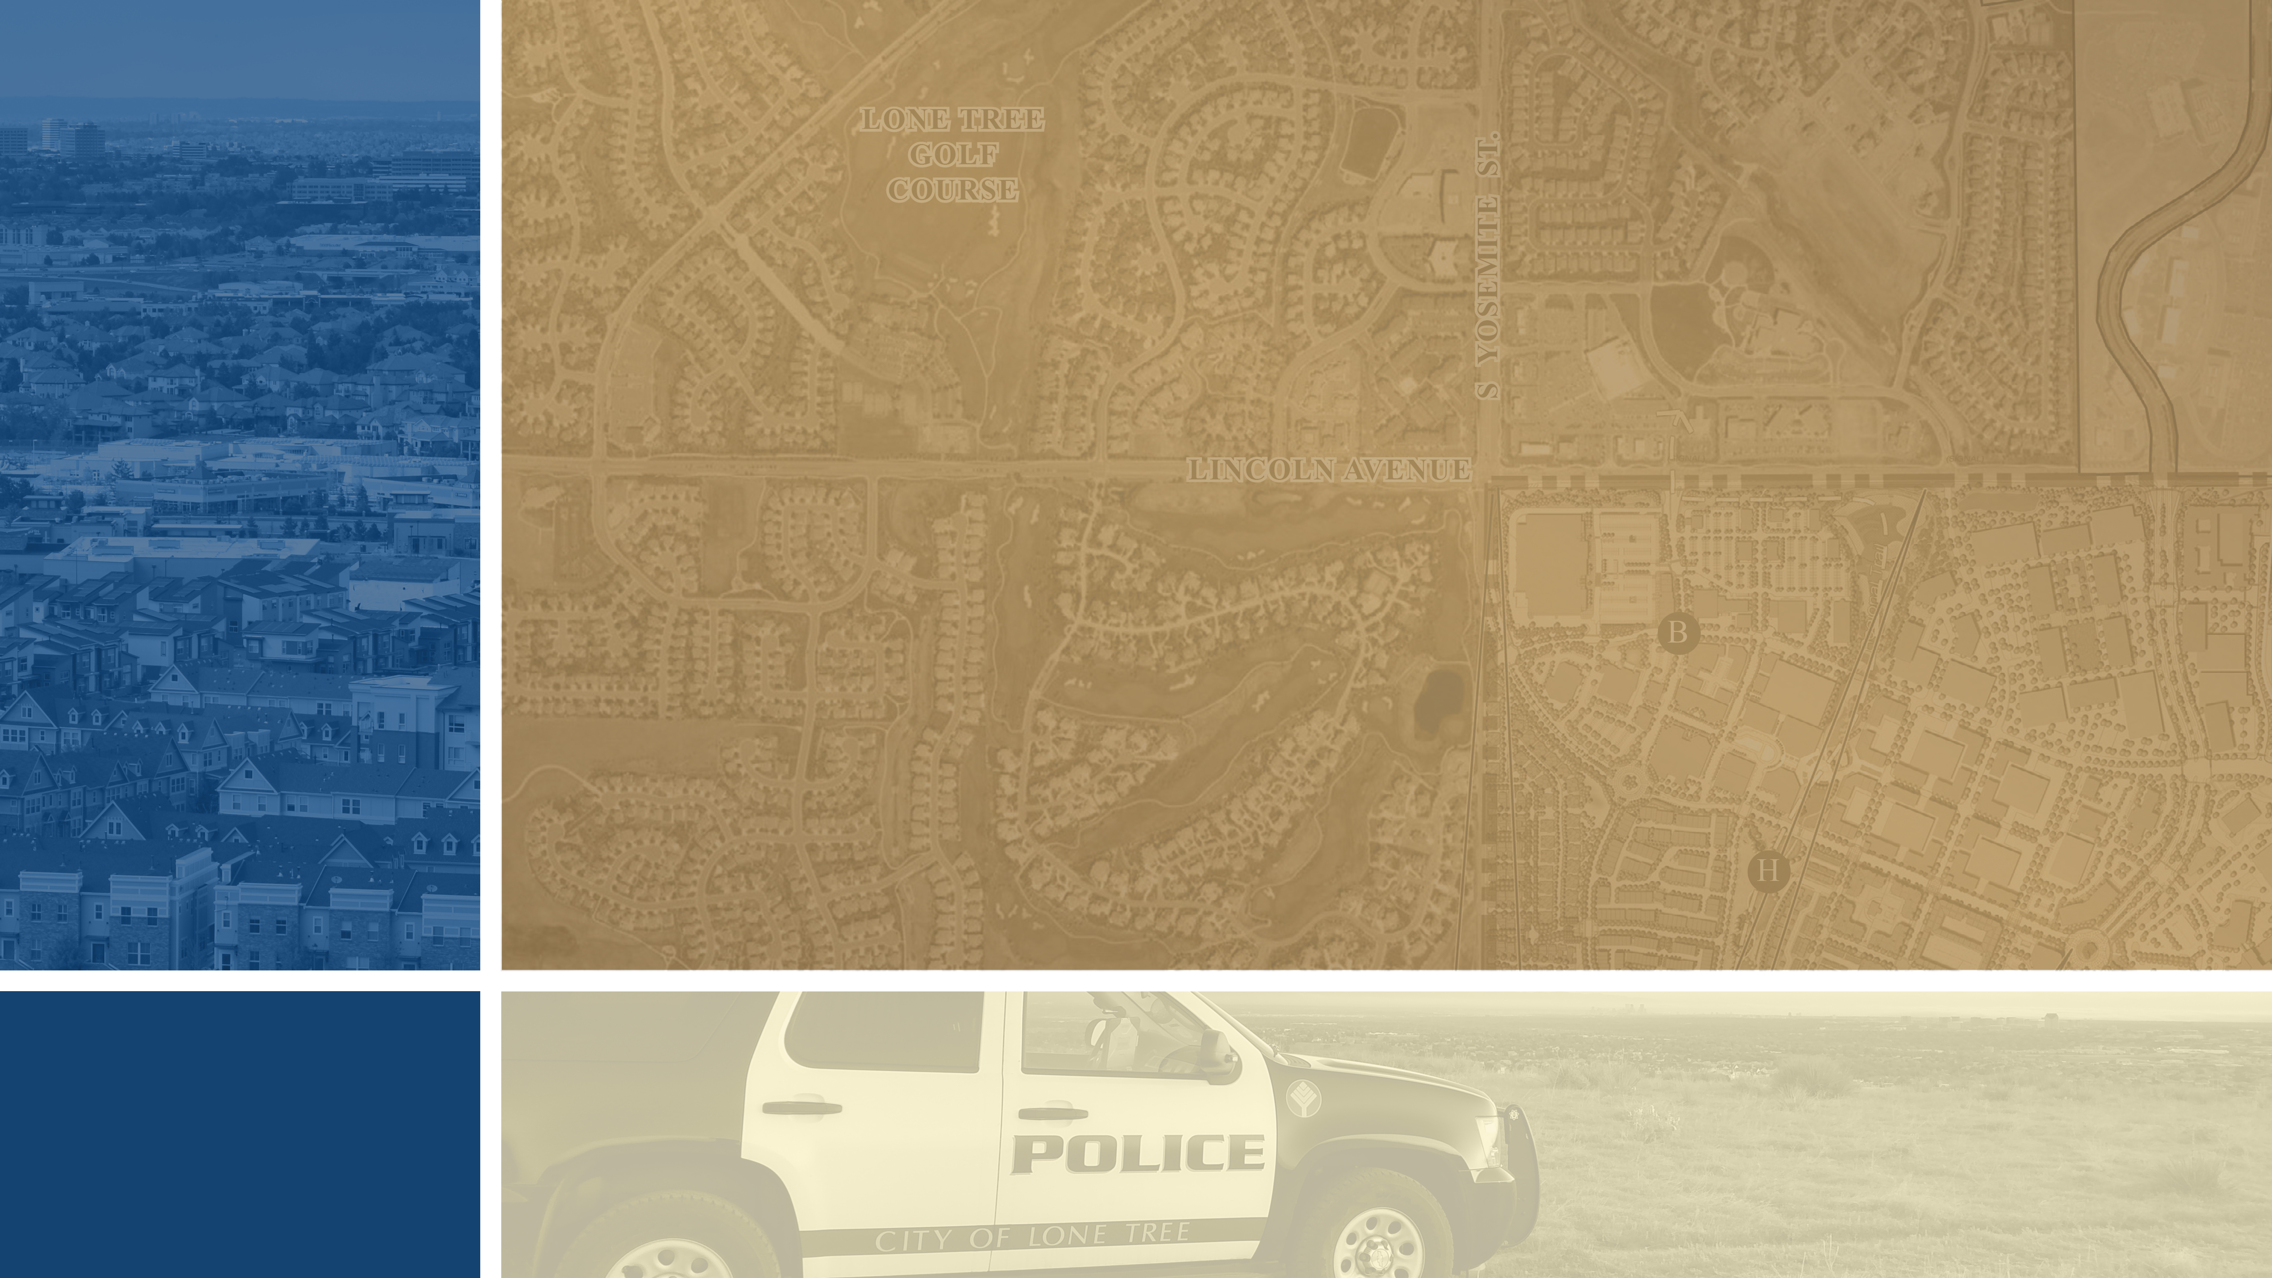
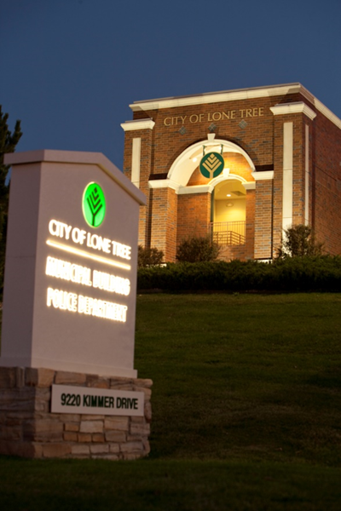


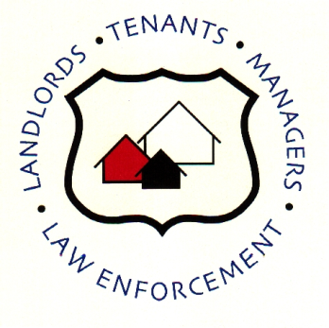
POLICE
DEPARTMENT
Police Department
Crime Free Partnership
Crime Free Apartment Maintenance Training
Start training /Next slide Click here

Slide 2

City of Lone Tree Crime Free Partnerships
POLICE
DEPARTMENT
Crime Free Multi-Housing Program
ADVANCED CRIME PREVENTION TECHNIQUES
Todays Objectives
Promote understanding of the direct relationship of the environment to criminal behavior.
Provide the community with the means to eliminate or reduce criminal activity.
Maintain property in a way that promotes the safety and security of its residents.
“Working together for a safer community”
Start training /Next slide Click here

Slide 3
City of Lone Tree Crime Free Partnerships
POLICE
DEPARTMENT
Crime Free Multi-Housing Program
ADVANCED CRIME PREVENTION TECHNIQUES
Disclaimer:
While we will address legal information in general, the Law deals with “specific facts” presented in each situation. The information presented here should not be relied upon as a substitute for legal advice. Always consult with an attorney.
Start training /Next slide Click here
“Working together for a safer community”

Slide 4
City of Lone Tree Crime Free Partnerships
POLICE
DEPARTMENT
Crime Free Multi-Housing Program
ADVANCED CRIME PREVENTION TECHNIQUES
Introduction-The purpose of the Crime Free Multi-Housing Program is to assist property managers in establishing certain protocols and guidelines to reduce criminal activity within their properties. This will not only benefit the properties in reducing criminal activity within their communities, it will also benefit the police department by decreasing calls for service and making the community a safer place to live.
This partnership between Multi-Housing properties and law enforcement agencies allows your respective properties to house those tenants that are legitimate, while deterring others with criminal intent. Less crime on your properties may also mean less liability, less maintenance costs due to repairs, less stress for management and more profit.
Start training /Next slide Click here
“Working together for a safer community”

Slide 5
City of Lone Tree Crime Free Partnership
POLICE
DEPARTMENT
History-
The Crime Free Multi-Housing Program began in Mesa, Arizona in July 1992. It has spread across the United States, Canada, and overseas to countries in a very short time. The programs are designed to be community-driven.
The results- In communities where Crime Free programs have been put in place. There has been a reduction of crime between 30%-90%.
Crime Free Programs are proven crime prevention Best Practices.
Start training /Next slide Click here

Slide 6
City of Lone Tree Crime Free Partnerships
POLICE
DEPARTMENT
Crime Free Multi-Housing Program
ADVANCED CRIME PREVENTION TECHNIQUES
CRIME FREE MULTI-HOUSING PROGRAM
Part 1: Crime Prevention through Environmental Design (CPTED)
Start training /Next slide Click here
“Working together for a safer community”

Slide 7
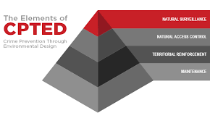
City of Lone Tree Crime Free Partnerships
POLICE
DEPARTMENT
Crime Free Multi-Housing Program
ADVANCED CRIME PREVENTION TECHNIQUES
The goal of CPTED
By altering the physical environment, citizens will be more capable of understanding the direct relationship of the environment to human behavior and crime.
CPTED is not the total answer to community problems, but it does provide the community with the means to eliminate or reduce criminal activity.
Start training /Next slide Click here
“Working together for a safer community”

Slide 8
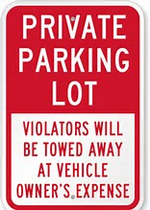
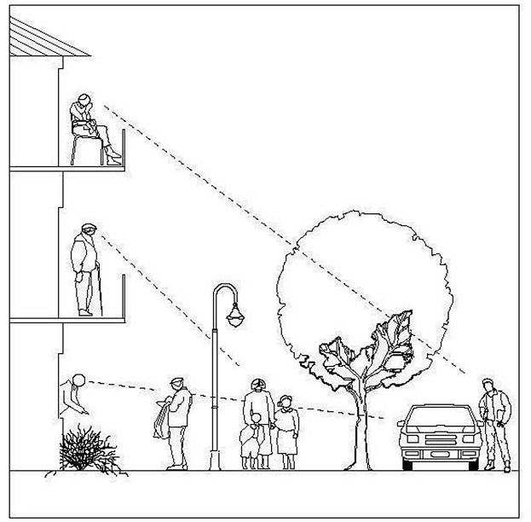
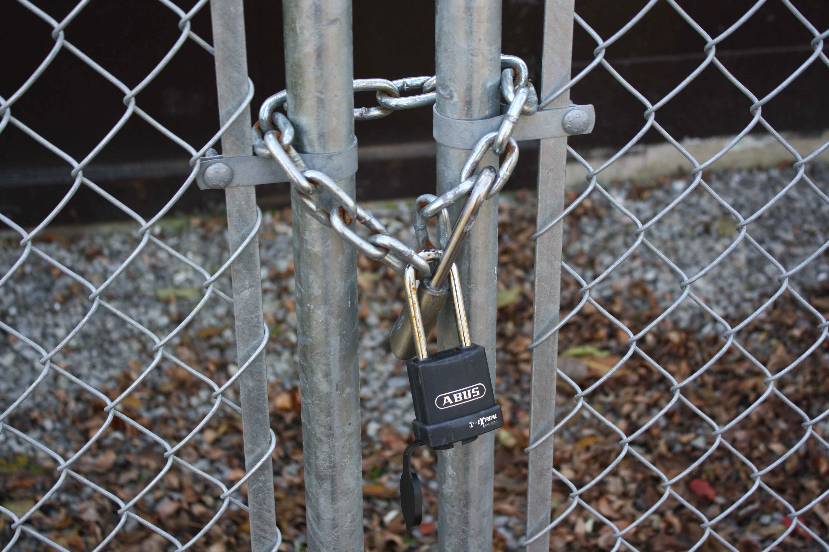
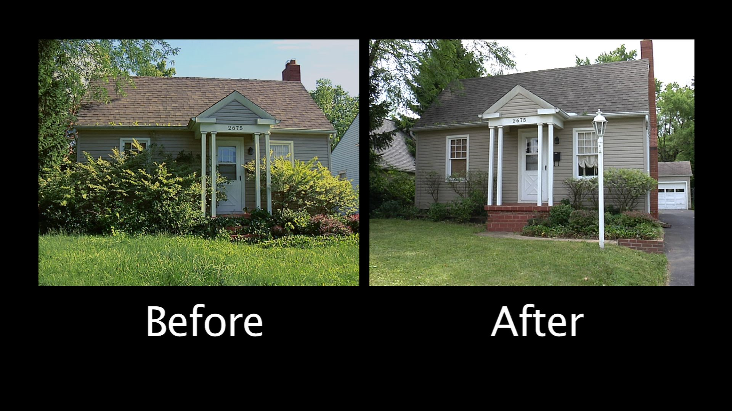
City of Lone Tree Crime Free Partnerships
POLICE
DEPARTMENT
The Basic Principals of CPTED
Crime Free Multi-Housing Program
ADVANCED CRIME PREVENTION TECHNIQUES
Territoriality
Natural Surveillance
Access Control
Maintenance
Start training /Next slide Click here
“Working together for a safer community”

Slide 9
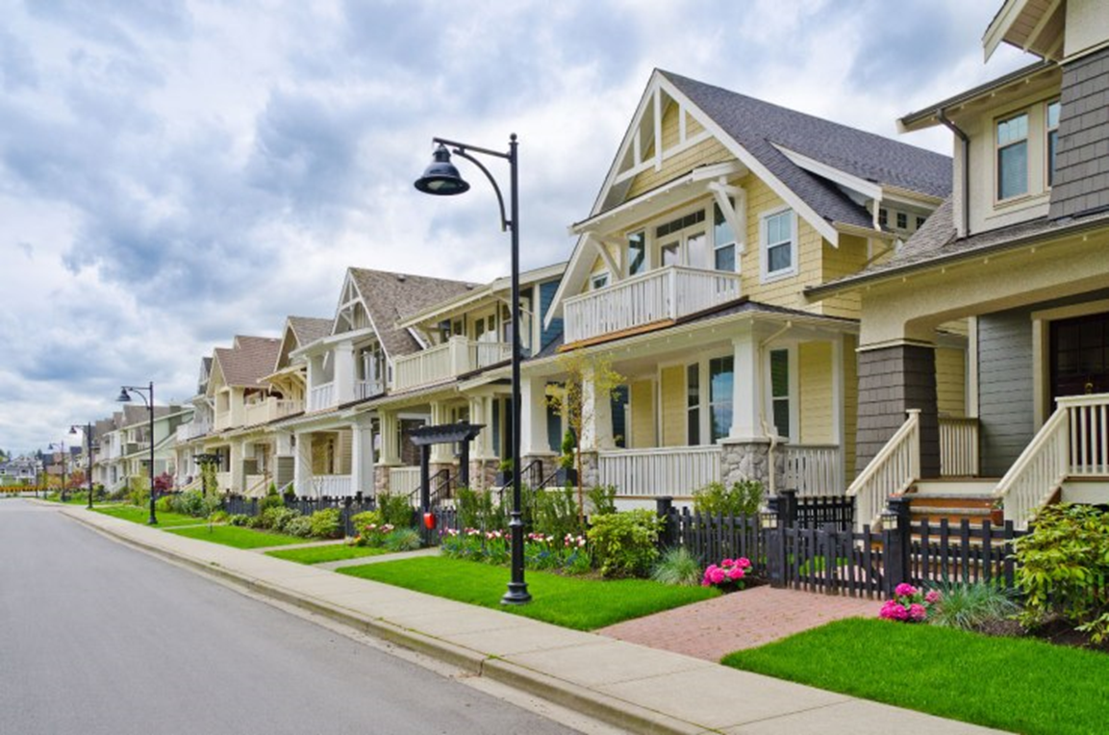
City of Lone Tree Crime Free Partnerships
POLICE
DEPARTMENT
Territoriality
The use of physical attributes that express ownership such as fencing, pavement treatments, signage, and landscaping to define a space as public, semi-public, semi-private, or private. It can prevent unauthorized use of space by unintended users.
Crime Free Multi-Housing Program
ADVANCED CRIME PREVENTION TECHNIQUES
Private Space
Public Space
Semi-Public Space
Start training /Next slide Click here
“Working together for a safer community”

Slide 10


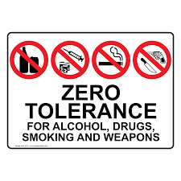
City of Lone Tree Crime Free Partnerships
POLICE
DEPARTMENT
Signage
Signs indicating ownership and proper use of spaces show that the property is cared for and follows a set of rules. They can be a deterrent to criminal activity and enable law enforcement to property enforce the rules and regulations of your property. Make sure that signs are upright and properly posted.
Crime Free Multi-Housing Program
ADVANCED CRIME PREVENTION TECHNIQUES
Start training /Next slide Click here
“Working together for a safer community”

Slide 11
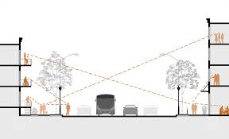
City of Lone Tree Crime Free Partnerships
POLICE
DEPARTMENT
Natural Surveillance
The ability of a person to observe, scrutinize, inspect, watch, view, or supervise the behavior and activities of another with limited or no artificial intervention. This can be created by uniquely designing building, activity locations, and landscaping features that provide maximum visibility.
Crime Free Multi-Housing Program
ADVANCED CRIME PREVENTION TECHNIQUES
This is based on the concept that criminals do not want to be observed committing crimes.
Start training /Next slide Click here
“Working together for a safer community”

Slide 12
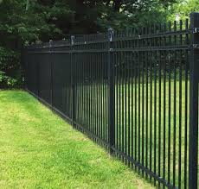
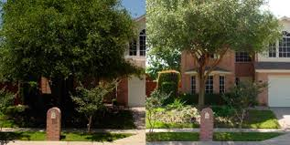
City of Lone Tree Crime Free Partnerships
POLICE
DEPARTMENT
Natural Surveillance
In order to facilitate natural surveillance, it is recommended that trees be trimmed about six feet and shrubbery be trimmed below three feet tall. Fencing should provide a clear view to the other side, and lights should be in working order.
Crime Free Multi-Housing Program
ADVANCED CRIME PREVENTION TECHNIQUES
Start training /Next slide Click here
“Working together for a safer community”

Slide 13
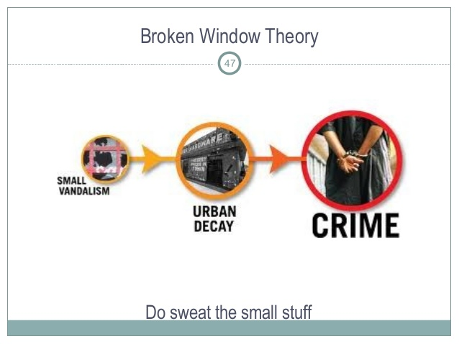
City of Lone Tree Crime Free Partnerships
POLICE
DEPARTMENT
CRIME PREVENTION CONCEPT: THE BROKEN WINDOW THEORY
An academic theory proposed by James Q. Wilson and George Kelling in 1982 that used broken window was a metaphor for disorder within neighborhoods. The theory links disorder and incivility within a community to subsequent occurrences of serious crime.
Crime Free Multi-Housing Program
ADVANCED CRIME PREVENTION TECHNIQUES
Start training /Next slide Click here
“Working together for a safer community”

Slide 14
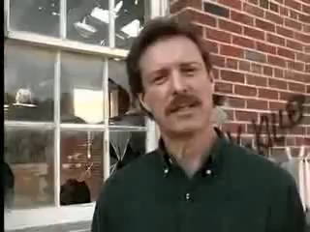
City of Lone Tree Crime Free Partnerships
POLICE
DEPARTMENT
Broken Windows Theory
Crime Free Multi-Housing Program
ADVANCED CRIME PREVENTION TECHNIQUES
Start training /Next slide Click here
“Working together for a safer community”

Slide 15

City of Lone Tree Crime Free Partnerships
POLICE
DEPARTMENT
Maintenance
Crime Free Multi-Housing Program
ADVANCED CRIME PREVENTION TECHNIQUES
Maintenance is an expression of responsibility and ownership of a property.
Deterioration indicates a lack of control by the intended users of a site, a lack of caring, and a greater tolerance of disorder.
Conveying a positive image in the community shows a sense of pride, caring, and self-worth.
Well maintained locations send a message to potential offenders that criminal activity will be noticed and reported.
Start training /Next slide Click here
“Working together for a safer community”

Slide 16
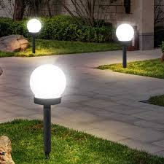
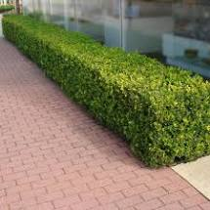
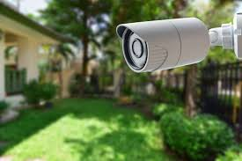
City of Lone Tree Crime Free Partnerships
POLICE
DEPARTMENT
Maintenance
Crime Free Multi-Housing Program
ADVANCED CRIME PREVENTION TECHNIQUES
  Bushes no more than 3’ high & trees trimmed up to 6’ or 7’.
  Replace lights which are not working.
  Keep alarms and cameras in good working condition. Alarms are no good if you do not use them.
Start training /Next slide Click here
“Working together for a safer community”

Slide 17
City of Lone Tree Crime Free Partnerships
POLICE
DEPARTMENT
Access Control
Crime Free Multi-Housing Program
ADVANCED CRIME PREVENTION TECHNIQUES
Restriction of access to a place or other resource and preventing offenders from consuming, entering, or using a location or other resource.
You can limit criminal opportunity by taking steps to clearly differentiate between public space and private space. Strategic placement of the following elements to limit or prevent access and control flow:
  - Entrances & exits - Pavement treatments
  - Fences - Activity support
  - Lights - Zones of transition
  - Landscape
Start training /Next slide Click here
“Working together for a safer community”

Slide 18
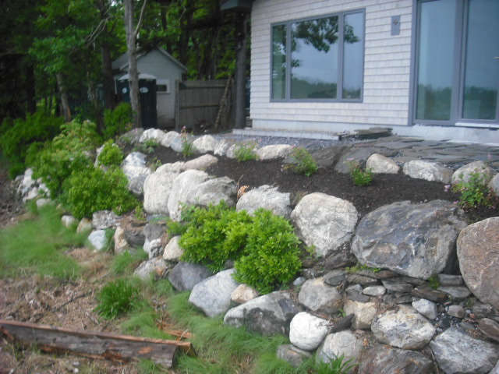
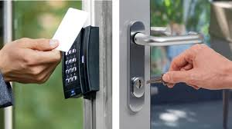
City of Lone Tree Crime Free Partnerships
POLICE
DEPARTMENT
Access Control
Crime Free Multi-Housing Program
ADVANCED CRIME PREVENTION TECHNIQUES
Natural Access Control Mechanical Access Control
Start training /Next slide Click here
“Working together for a safer community”

Slide 19
City of Lone Tree Crime Free Partnerships
POLICE
DEPARTMENT
Access Control
Crime Free Multi-Housing Program
ADVANCED CRIME PREVENTION TECHNIQUES
Access control can be natural, such as having rocks or hostile landscaping preventing ingress or egress to certain areas, or mechanical, such as using locks for private areas.
It is important to check the access control to all areas, but specially to private spaces. Locks should be checked regularly, and it should be ensured that areas are only accessible by those people who have a reason to be in that space.
“Working together for a safer community”

Slide 20
City of Lone Tree Crime Free Partnerships
POLICE
DEPARTMENT
Preventing Crime
Crime Free Multi-Housing Program
ADVANCED CRIME PREVENTION TECHNIQUES
Recommended target hardening steps:
Use disc locks to secure lockers
Install plates in front of locks to deter prying
Install CPTED fencing (see previous slide)
Install cameras and motion sensors
Ensure property is well lit, especially less traveled areas and hiding spots
Post signage (no trespassing, cameras on property, etc)
Maintain landscaping, trees should be trimmed above 6 feet tall, and shrubbery should be no taller than 3 feet
Start training /Next slide Click here
“Working together for a safer community”

Slide 21
City of Lone Tree Crime Free Partnerships
POLICE
DEPARTMENT
Suspicious or Suspect Stolen Property
If the suspicious item of concern or suspected stolen item it should be left where it was found and reported to law enforcement. Staff should ask for direction from law enforcement on moving or securing the item, if appropriate.
Suspected Abandoned or Stolen Vehicle
Report the license plate to police dispatch. If no license plate exists, report the VIN and description to police dispatch.
If the vehicle is stolen police will respond. If the vehicle is abandoned follow your policy on private removal of the vehicle
Crime Free Multi-Housing Program
ADVANCED CRIME PREVENTION TECHNIQUES
“Working together for a safer community”

Slide 22
City of Lone Tree Crime Free Partnerships
POLICE
DEPARTMENT
Possible Indicators of Drug Activity
Coming and going late at night
Varied vehicles associated with apartment, possible with border state license plates
Lots of shipping/packaging materials
Food saver products for sealing drug products.
Large rolls of plastic wraps and heat seal products.
Odor concealing products like fabric softeners and oils based products (grease).
Crime Free Multi-Housing Program
ADVANCED CRIME PREVENTION TECHNIQUES
“Working together for a safer community”

Slide 23
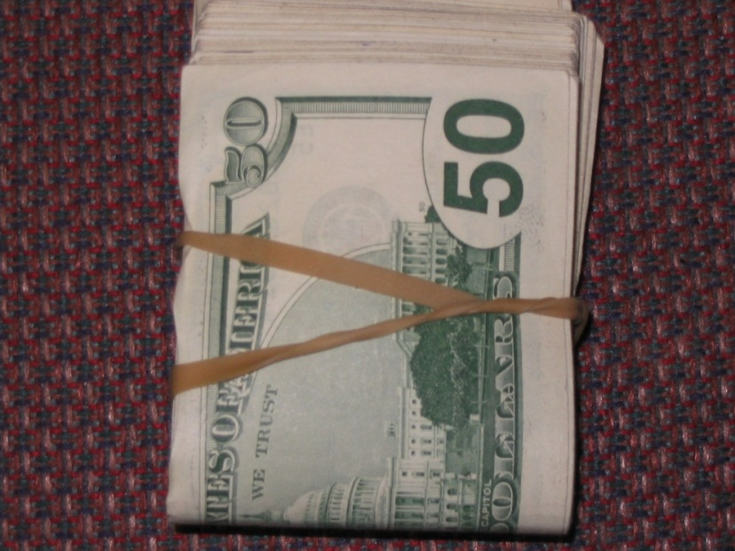

City of Lone Tree Crime Free Partnerships
POLICE
DEPARTMENT
Drug Indicators
Crime Free Multi-Housing Program
ADVANCED CRIME PREVENTION TECHNIQUES
Guests displaying large amounts of money (money packaged in bundles, small bundles wrapped with rubber bands) and paying cash for their rooms and for services.
Look out for needle caps in the room. If you see them discarded, you should be extremely cautious when cleaning the room. Needles are often hidden from view.
“Working together for a safer community”

Slide 24
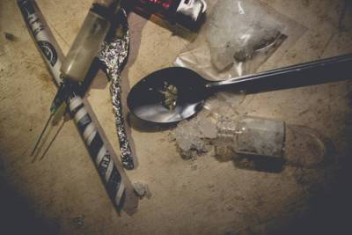

City of Lone Tree Crime Free Partnerships
POLICE
DEPARTMENT
Drug Related Items
  Drug related items include:
    - Needles
    - Glassware, pipes
    - Bags
    - Other debris
  If no suspect or other suspicious circumstances these should be reported to your supervisor and disposed of safely into an appropriate container
Crime Free Multi-Housing Program
ADVANCED CRIME PREVENTION TECHNIQUES
Start training /Next slide Click here
“Working together for a safer community”

Slide 25
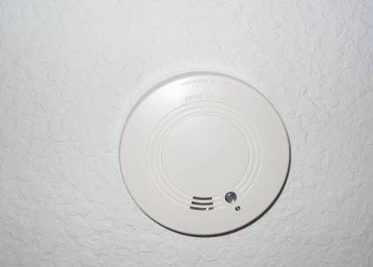
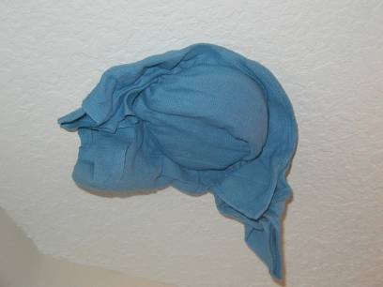
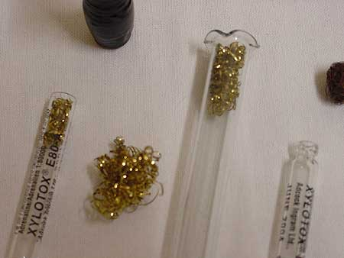
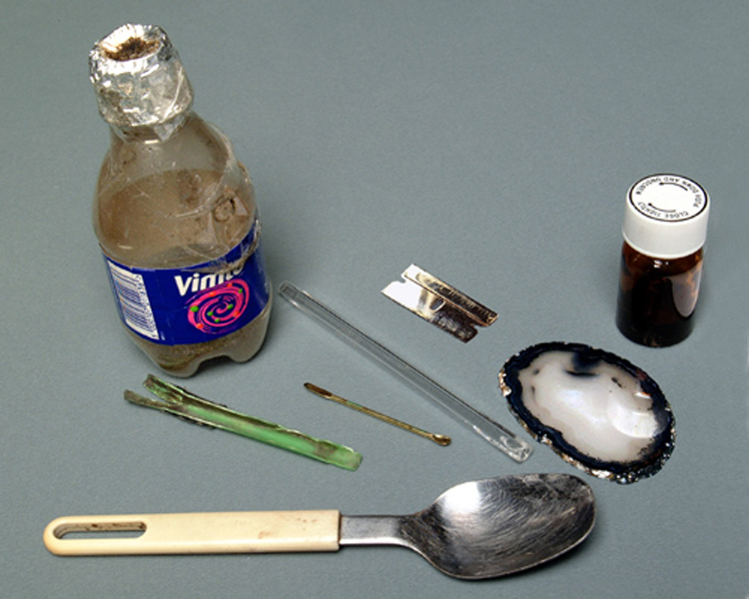
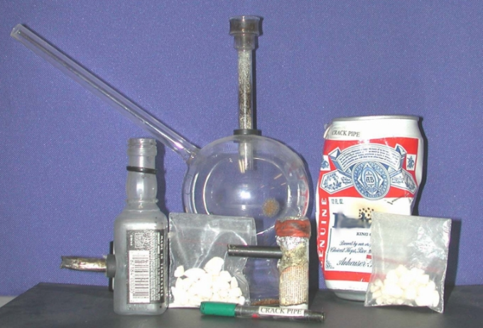
City of Lone Tree Crime Free Partnerships
POLICE
DEPARTMENT
Drug Indicators
Crime Free Multi-Housing Program
ADVANCED CRIME PREVENTION TECHNIQUES
Smoke Detectors covered or disabled
Paraphernalia

Slide 26
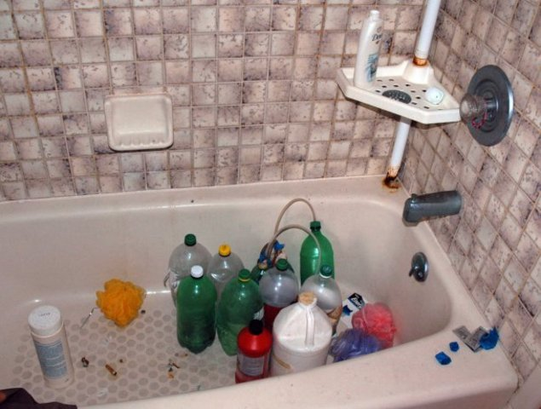
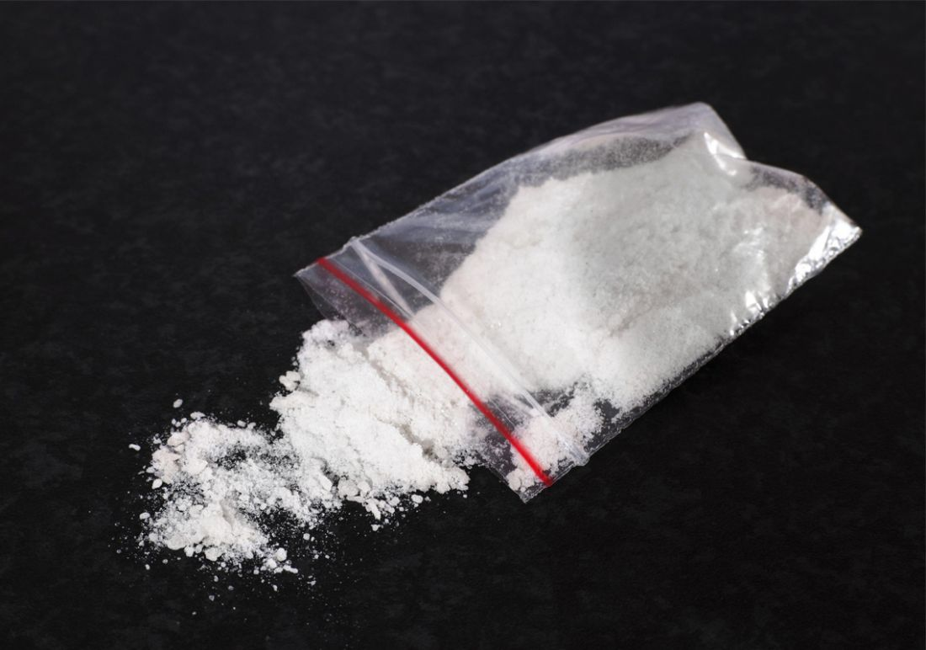
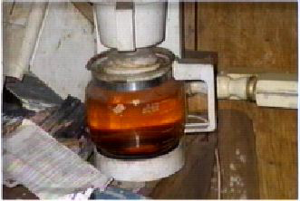
City of Lone Tree Crime Free Partnerships
POLICE
DEPARTMENT
Methamphetamine
Crime Free Multi-Housing Program
ADVANCED CRIME PREVENTION TECHNIQUES
Chemicals Used To Make Methamphetamine
Alcohol
Ether
Benzene
Paint Thinner
Freon
Acetone
Coleman Fuel
Anhydrous ammonia
Iodine Crystals
Energy Boosters
Cold Packs
Red Phosphorous
Lye (Red Devil Lye)
Drano
Muriatic Acid
Epsom Salt
Lithium(Batteries)
Sodium Metal
Ephedrine
Rock Salt
Cold Tablets
Fertilizer
Smell for an unusually strong chemical odor that is out of place for the location
Indicators for Methamphetamine Production
Look for excessive amounts of the chemicals used to manufacture meth or the packaging containers for the chemicals
Meth is usually off white; common colors are white, red, brown, yellow, green, pink, and blue
“Working together for a safer community”

Slide 27
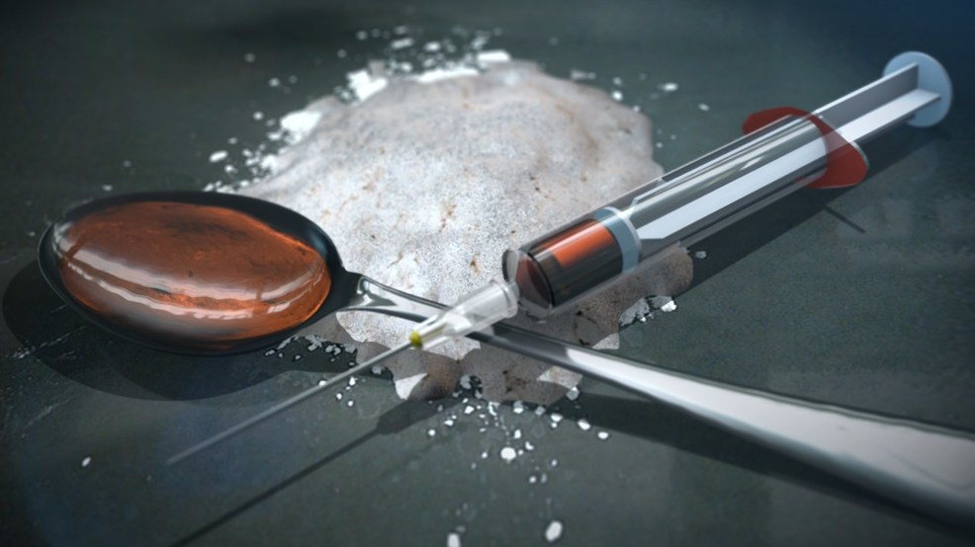
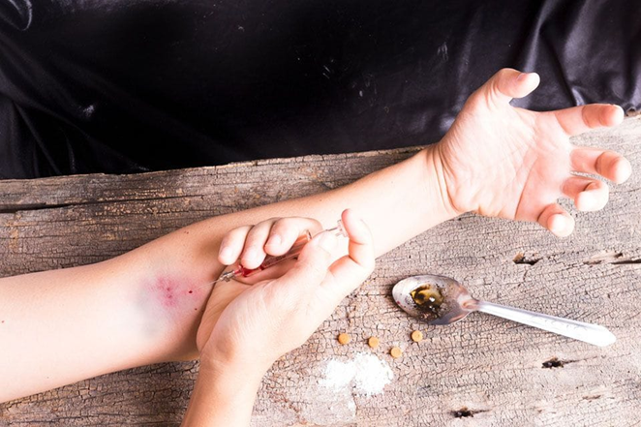
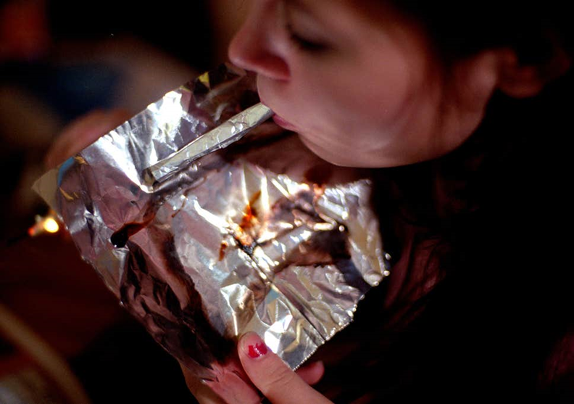
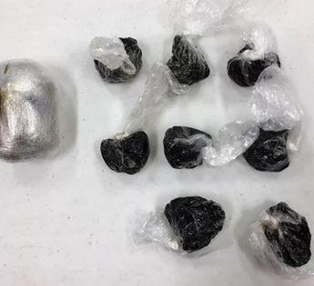
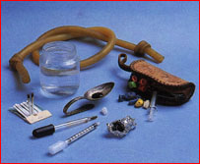
City of Lone Tree Crime Free Partnerships
POLICE
DEPARTMENT
Crime Free Multi-Housing Program
ADVANCED CRIME PREVENTION TECHNIQUES
Heroin Paraphernalia
“Working together for a safer community”

Slide 28

City of Lone Tree Crime Free Partnerships
POLICE
DEPARTMENT
Evidence Handling
Anything suspicious – leave the scene, do not touch anything and secure the location for law enforcement.
Inform your supervisor and call 911.
Suspicious circumstance may include but are not limited to:
  - Blood, hazardous materials, firearms or other weapon, signs of struggle or assault, theft or criminal trespass.
Crime Free Multi-Housing Program
ADVANCED CRIME PREVENTION TECHNIQUES
“Working together for a safer community”

Slide 29
City of Lone Tree Crime Free Partnerships
POLICE
DEPARTMENT
Thank you for taking the time to complete the International Crime Free Association, Crime Free Multi Housing Maintenance training course.
If you have any questions or concerns, contact the Community Partnership Unit at:
(303) 339-8150
Or email:
CPU@cityoflonetree.com
Crime Free Multi-Housing Program
ADVANCED CRIME PREVENTION TECHNIQUES
Start training /Next slide Click here
“Working together for a safer community”

