Slide 1

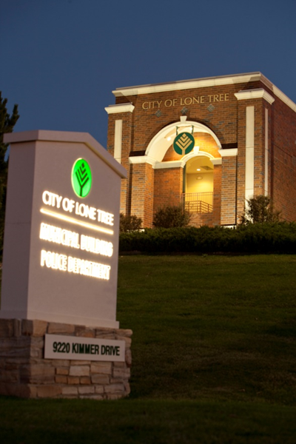



POLICE
DEPARTMENT
Police Department
Crime Free Partnership
CRIME FREE Self Storage Employee Training

Slide 2

City of Lone Tree Crime Free Partnerships
POLICE
DEPARTMENT
Crime Free Self Storage Program
ADVANCED CRIME PREVENTION TECHNIQUES
Todays Objectives
Create a proactive partnership between Self Storage Facilities and the Lone Tree Police Department.
Create relationships between Self Storage Facilities.
Discuss and share information on current criminal trends at Self Storage Facilities, both locally and across the nation.
Problem solve criminal activity and work together to find solutions to keep our properties safe.
(A working group that meets regularly)
Discuss how Crime Free Self Storage Program works to reduce the chances of criminal activity at your location.
“Working together for a safer community”
Start training /Next slide Click here

Slide 3
City of Lone Tree Crime Free Partnerships
POLICE
DEPARTMENT
Crime Free Self Storage Program
ADVANCED CRIME PREVENTION TECHNIQUES
Disclaimer:
While we will address legal information in general, the Law deals with “specific facts” presented in each situation. The information presented here should not be relied upon as a substitute for legal advice. Always consult with an attorney.
Start training /Next slide Click here
“Working together for a safer community”

Slide 4
City of Lone Tree Crime Free Partnerships
POLICE
DEPARTMENT
Crime Free Self Storage Program
ADVANCED CRIME PREVENTION TECHNIQUES
Introduction-The purpose of the Crime Free Self Storage Program is to assist property managers in establishing certain protocols and guidelines to reduce criminal activity within their properties. This will not only benefit the properties in reducing criminal activity within their properties, it will also benefit the police department by decreasing calls for service and making the facility a more secure business.
This partnership between Self Storage properties and law enforcement agencies allows your respective properties to rent to those tenants that are legitimate, while deterring others with criminal intent. Less crime on your properties may also mean less liability, less maintenance costs due to repairs, less stress for management and more profit.
Start training /Next slide Click here
“Working together for a safer community”

Slide 5
City of Lone Tree Crime Free Partnership
POLICE
DEPARTMENT
History-
The Crime Free Mini-Storage Program began in Mesa, Arizona in July 1992. It has spread across the United States, Canada, and overseas to countries in a very short time. The programs are designed to be community-driven.
The results- In facilities where Crime Free programs have been put in place. There has been a reduction of crime between 30%-90%.
Crime Free Programs are proven crime prevention Best Practices.
Start training /Next slide Click here

Slide 6

City of Lone Tree Crime Free Partnerships
POLICE
DEPARTMENT
Goals for the Program
Reduce burglaries in storage lockers
Increase property recovery rate in storage lockers
Decrease time delay from crime to discovery
Prevent criminals from renting storage lockers
Have your facility 100% occupied with law abiding customers
Crime Free Self Storage Program
ADVANCED CRIME PREVENTION TECHNIQUES
Start training /Next slide Click here
“Working together for a safer community”

Slide 7
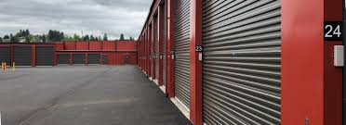
City of Lone Tree Crime Free Partnerships
POLICE
DEPARTMENT
Crime Free Self Storage Program
Crime Free Self Storage Program
ADVANCED CRIME PREVENTION TECHNIQUES
This program consists of three steps: completing training for management and employees, completing a C.P.T.E.D. Inspection (Crime Prevention Through Environmental Design), and posting Crime Free Self Storage Signs on the property.
After the training is completed, a member of the police department will conduct an inspection of the property looking for a set of standard requirements. They include controlled access in and out, acceptable security lighting, no trespassing signs, cleanliness, and required security measures. After the inspection, the Crime Free Self Storage Sign must be displayed on the property. It can also be used on advertisements, business cards, letterheads, flyers, etc.
Start training /Next slide Click here
“Working together for a safer community”

Slide 8
City of Lone Tree Crime Free Partnerships
POLICE
DEPARTMENT
Crime Free Self Storage Program
ADVANCED CRIME PREVENTION TECHNIQUES
CRIME FREE SELF STORAGE PROGRAM
Part 1: Training
Start training /Next slide Click here
“Working together for a safer community”

Slide 9
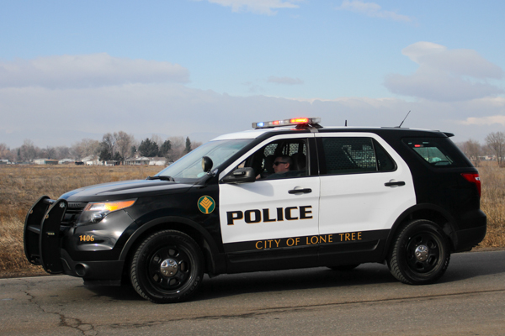
City of Lone Tree Crime Free Partnerships
POLICE
DEPARTMENT
Crime Free Self Storage Program
Crime Free Self Storage Program
ADVANCED CRIME PREVENTION TECHNIQUES
The first part of the Crime Free Self Storage Program is to get staff at the faculties trained in preventing crime in your facility, warning signs of illegal activity, screening renters, and active management.
This power point will provide you with the necessary training to continue in the Crime Free certification process. It is recommended that all employees take this training. Upon completion, certificates will be issued that can be posted at the facility.
Start training /Next slide Click here
“Working together for a safer community”

Slide 10

City of Lone Tree Crime Free Partnerships
POLICE
DEPARTMENT
Preventing Crime
There are three necessary elements for a crime to occur:
Crime Free Self Storage Program
ADVANCED CRIME PREVENTION TECHNIQUES
You can stop crime by taking away just one of those three elements.
You can do this using a technique called “target hardening”. This means making the target more secure, and reducing the opportunity of criminal activity. It may also reduce the desire of the criminal due to the amount of effort needed to commit the crime.
Start training /Next slide Click here
“Working together for a safer community”

Slide 11

City of Lone Tree Crime Free Partnerships
POLICE
DEPARTMENT
Crime Free Self Storage Program
ADVANCED CRIME PREVENTION TECHNIQUES
Most Criminals look for:
-Easy targets
-The unaware environment
-The fearful
-The path of least resistance
Your work in Crime Free Programs will keep the City of Lone Tree from becoming an easy target.
“Working together for a safer community”

Slide 12
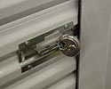
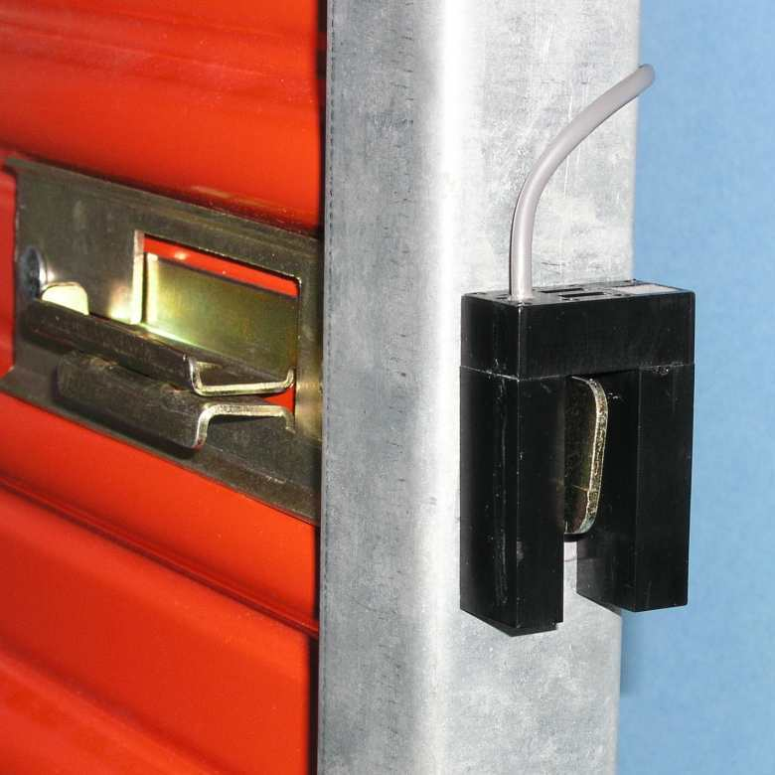
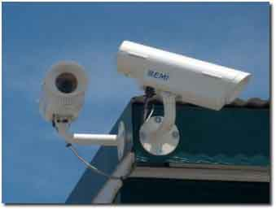
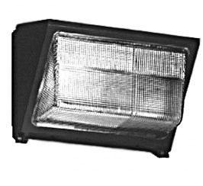
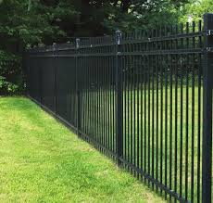

City of Lone Tree Crime Free Partnerships
POLICE
DEPARTMENT
Target Hardening
There are many ways to make your target more secure.
Crime Free Self Storage Program
ADVANCED CRIME PREVENTION TECHNIQUES
Start training /Next slide Click here
“Working together for a safer community”

Slide 13
City of Lone Tree Crime Free Partnerships
POLICE
DEPARTMENT
You should call the police department for:
Suspicious Activity
Theft
Vandalism/Property Damage
Drug Incidents
Criminal Trespasses
Fights/Assaults
Crime Free Self Storage Program
ADVANCED CRIME PREVENTION TECHNIQUES
“Working together for a safer community”

Slide 14
City of Lone Tree Crime Free Partnerships
POLICE
DEPARTMENT
Preventing Crime
Crime Free Self Storage Program
ADVANCED CRIME PREVENTION TECHNIQUES
Recommended target hardening steps:
Use disc locks to secure lockers
Install plates in front of locks to deter prying
Install CPTED fencing (see previous slide)
Install cameras and motion sensors
Ensure property is well lit, especially less traveled areas and hiding spots
Post signage (no trespassing, cameras on property, etc)
Maintain landscaping, trees should be trimmed above 6 feet tall, and shrubbery should be no taller than 3 feet
Start training /Next slide Click here
“Working together for a safer community”

Slide 15
City of Lone Tree Crime Free Partnerships
POLICE
DEPARTMENT
Warning Signs of Illegal Activity
Crime Free Self Storage Program
ADVANCED CRIME PREVENTION TECHNIQUES
Possible Indicators of Drug Activity
Coming and going late at night
Varied vehicles associated with locker, possible with border state license plates
Lots of shipping/packaging materials
Food saver products for sealing drug products.
Large rolls of plastic wraps and heat seal products.
Odor concealing products like fabric softeners and oil-based products (grease).
Start training /Next slide Click here
“Working together for a safer community”

Slide 16
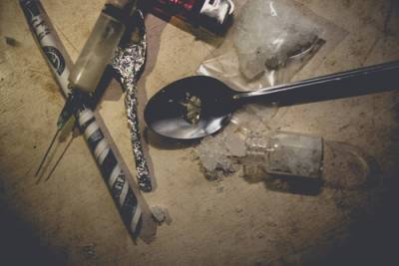

City of Lone Tree Crime Free Partnerships
POLICE
DEPARTMENT
Drug Related Items
  Drug related items include:
    - Needles
    - Glassware, pipes
    - Bags
    - Other debris
  If no suspect or other suspicious circumstances these should be reported to your supervisor and disposed of safely into an appropriate container
Crime Free Self Storage Program
ADVANCED CRIME PREVENTION TECHNIQUES
Start training /Next slide Click here
“Working together for a safer community”

Slide 17
City of Lone Tree Crime Free Partnerships
POLICE
DEPARTMENT
Warning Signs of Illegal Activity
Crime Free Self Storage Program
ADVANCED CRIME PREVENTION TECHNIQUES
Suspicious or Suspected Stolen Property
If the suspicious item of concern or suspected stolen item it should be left where it was found and reported to law enforcement. Staff should ask for direction from law enforcement on moving or securing the item, if appropriate.
Suspected Abandoned or Stolen Vehicle
Report the license plate to police dispatch. If no license plate exists, report the VIN and description to police dispatch.
If the vehicle is stolen police will respond. If the vehicle is abandoned follow your policy on private removal of the vehicle
Start training /Next slide Click here
“Working together for a safer community”

Slide 18

City of Lone Tree Crime Free Partnerships
POLICE
DEPARTMENT
Evidence Handling
Crime Free Self Storage Program
ADVANCED CRIME PREVENTION TECHNIQUES
Anything suspicious – leave the scene, do not touch anything and secure the location for law enforcement.
Inform your supervisor and call 911.
Suspicious circumstance may include but are not limited to:
  - Blood, hazardous materials, firearms or other weapon, signs of struggle or assault, theft or criminal trespass.
Start training /Next slide Click here
“Working together for a safer community”

Slide 19

City of Lone Tree Crime Free Partnerships
POLICE
DEPARTMENT
Screening Renters
Do you require or have a Crime Free Addendum in your lease agreement?
A Crime Free Addendum is a legal document which allows you to act if criminal activity is occurring.
Do you present the Addendum with the rental application?
Presenting the Crime Free Addendum at the time of the application may detour a renter who may have criminal intent. This should be done before any fees or deposits.
Do you verify identification?
Always have the applicant provide a valid identification and if possible, 2 forms of valid identification.
Consider requiring a fingerprint to accompany paperwork.
Crime Free Self Storage Program
ADVANCED CRIME PREVENTION TECHNIQUES
Start training /Next slide Click here
“Working together for a safer community”

Slide 20
City of Lone Tree Crime Free Partnerships
POLICE
DEPARTMENT
Crime Free Lease Addendum
Consider attaching a Crime Free Lease Addendum to your screening process in order to dissuade any individuals potentially involved in criminal activity. The addendum could include pieces such as:
Renter (and guests) agree not to engage in or facilitate illegal activity on the premises
Not permitting the unit to be used for or facilitate illegal activity
Not engaging in the manufacture, sale, or distribution or illegal drugs
Not engaging in acts or threats of violence
Any violation of this addendum is a serious violation and good cause for termination
In the event of a criminal investigation, information will be provided to police
Crime Free Self Storage Program
ADVANCED CRIME PREVENTION TECHNIQUES
Start training /Next slide Click here
“Working together for a safer community”

Slide 21

City of Lone Tree Crime Free Partnerships
POLICE
DEPARTMENT
Active Management
Crime Free Self Storage Program
ADVANCED CRIME PREVENTION TECHNIQUES
Understand crime and the criminal mind.
Criminals are like predators- looking for easy victims.
Crime IS a community problem and crime prevention MUST be a community effort.
Crime prevention is a shared responsibility.
Active Property Management can stop criminal activity before it enters your rental community.
Start training /Next slide Click here
“Working together for a safer community”

Slide 22

City of Lone Tree Crime Free Partnerships
POLICE
DEPARTMENT
Active Management
Crime Free Self Storage Program
ADVANCED CRIME PREVENTION TECHNIQUES
Do you have regular safety and security meetings with the management team?
Do you have regular safety and security training for employees?
Are all security equipment cameras, alarms, safe, and lighting functioning properly and do you inspect this regularly?
Are cameras recorded?
Are there hiding places or places where unwanted activity occurs?
Do you have reoccurring problems and have you problem solved a strategy to solve this activity?
Start training /Next slide Click here
“Working together for a safer community”

Slide 23
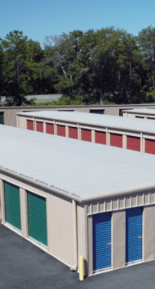
City of Lone Tree Crime Free Partnerships
POLICE
DEPARTMENT
Active Management
Crime Free Self Storage Program
ADVANCED CRIME PREVENTION TECHNIQUES
Engage With Your Tenants
Maintain security by encouraging your staff to be not only friendly and courteous with customers, but to also take an interest and get to know them when appropriate. You have the opportunity to meet people from all walks of life in the and may potentially spot any nefarious characters if you get involved.
Always Check Credentials
Train your staff to verify the identity of every contractor that walks onto your property, whether they’re delivering flowers or fixing a sink. Make sure you thoroughly check the background of any contract partners as well, such as security officers or landscapers.
Consider Controlling After-Hours Access
There’s a balance between customer service and security; your customers should feel both welcome and safe.
Start training /Next slide Click here
“Working together for a safer community”

Slide 24
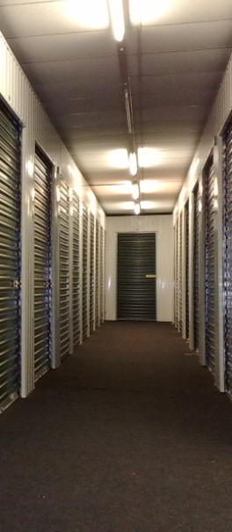
City of Lone Tree Crime Free Partnerships
POLICE
DEPARTMENT
Active Management
Crime Free Self Storage Program
ADVANCED CRIME PREVENTION TECHNIQUES
Update Keys and Locks
Make sure your employees and contractors are well-trained regarding how keys are distributed. Re-key lockers between tenants. Disc locks are recommended as they are the hardest to cut open.
Provide Staff With Uniforms and Name Tags
You should consider outfitting your employees in company-issued uniforms and having them wear name tags. A properly uniformed staff allows them to be easily distinguished. It not only helps tenants easily identify who they can reach out to for assistance, but it can also make them feel safe, knowing that your staff is constantly keeping an eye on the property.
Start training /Next slide Click here
“Working together for a safer community”

Slide 25

City of Lone Tree Crime Free Partnerships
POLICE
DEPARTMENT
Active Management
Crime Free Self Storage Program
ADVANCED CRIME PREVENTION TECHNIQUES
Monitor Your Closed-Circuit Television
It’s not enough to just install cameras; make sure to check them, too. There are activity-activated cameras that issue an alert when there’s activity somewhere there shouldn’t be, or you might hire a third party to monitor your cameras. Some systems have voice-command capabilities, meaning you can not only monitor, but also verbally warn people off.
Regularly Evaluate and Make Changes
You should be reviewing property conditions on a regular schedule. Consider using checklists to ensure that areas like stairwells and hallways are well-lit, clean and safe.
Have a Clear Emergency Response Plan
Make sure your management team meets with law enforcement and emergency services on a regular basis, so there’s good two-way communication, and update your emergency plans as needed.
Start training /Next slide Click here
“Working together for a safer community”

Slide 26
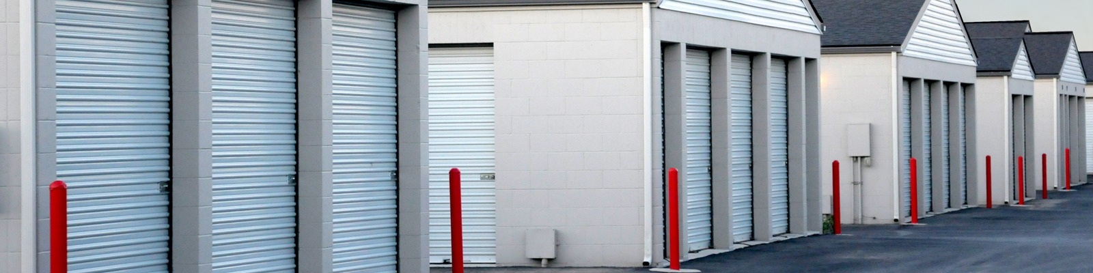
City of Lone Tree Crime Free Partnerships
POLICE
DEPARTMENT
Active Management
Crime Free Self Storage Program
ADVANCED CRIME PREVENTION TECHNIQUES
Failure To Maintain The Premises: This one seems like common sense — the management has a responsibility to make sure that the property is kept in good condition. Sometimes criminals may take advantage of things like faulty locks or windows in order to gain access to apartments.
Inadequate Lighting: If there is not sufficient lighting in parking lots or hallways, the property may be putting tenants at risk. Dark hallways may result in accident or injury, and dimly lit parking lots may invite the possibility of crime or injury as well.
The management has a duty to make sure that these things and other items are properly maintained and repaired.
Employee theft: You may have an action against an individual staff member if that staff member is responsible for your stolen property.
Start training /Next slide Click here
“Working together for a safer community”

Slide 27

City of Lone Tree Crime Free Partnerships
POLICE
DEPARTMENT
Other Safety Tips
Notify another person
Prospect enters first
Stay near exit
Leave door open
Be aware of your surroundings
Lock doors when working late
Report suspicious activity
Keep vacant units secured
Never accept cash
Use 2-Way radios or cell
Safety apps – noonlight
Crime Free Self Storage Program
ADVANCED CRIME PREVENTION TECHNIQUES
Start training /Next slide Click here
“Working together for a safer community”

Slide 28

City of Lone Tree Crime Free Partnerships
POLICE
DEPARTMENT
What can you do?
Join Lone Tree Crime Free Self Storage Program:
Policy review- Make changes related to current criminal activity
Rental process – Check forms of identification and verify them. Crime Free Addendum at the time of application.
Meetings-The topic of security, safety and liability are regular discussed at management meetings.
Train employees – On policies, to report suspicious activity, to be observant, and giving excellent customer service.
Use deterrents – Crime Free Addendum, deposits, display Crime Free Program on doors and desks.
Crime Free Self Storage Program
ADVANCED CRIME PREVENTION TECHNIQUES
“Working together for a safer community”
Start training /Next slide Click here

Slide 29
City of Lone Tree Crime Free Partnerships
POLICE
DEPARTMENT
Thank you for taking the time to complete the International Crime Free Association, Crime Free Self Storage Employee training course.
One more step and your property will be Crime Free Certified. Schedule your Crime Prevention Through Environmental Design property inspection.
Contact the Community Partnership Unit at:
(303) 339-8150
Or emailing:
CPU@cityoflonetree.com
Crime Free Self Storage Program
ADVANCED CRIME PREVENTION TECHNIQUES
Start training /Next slide Click here
“Working together for a safer community”

